Slide 1

NSG Pilkington – University of Liverpool Machine Learning Project: 09/09/2020
Dr. Peter Green
Diego Echeverria
Risk Institute,
School of Engineering
11/08/2020

Slide 2
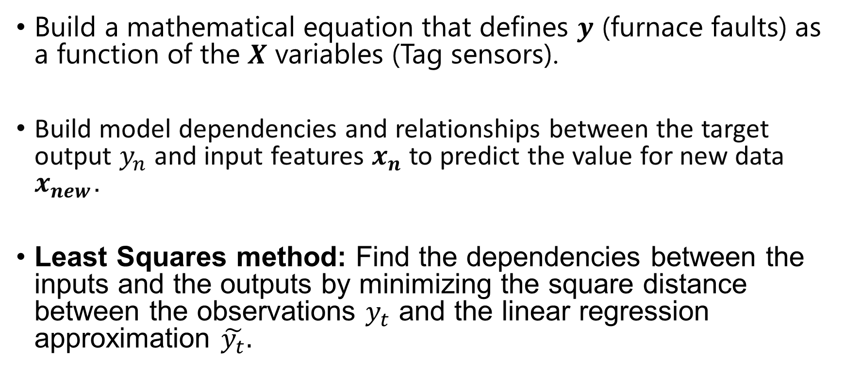
Regression using Machine Learning techniques
Build a mathematical equation that defines $y$ (furnace faults) as a function of the $X$ variables (Tag sensors).
Build model dependencies and relationships between the target output $y_{n}$ and input features $x_{n}$ to predict the value for new data $x_{new}$.
Least Squares method: Find the dependencies between the inputs and the outputs by minimizing the square distance between the observations $y_{t}$ and the linear regression approximation $\tilde{y_{t}}.$

Slide 3

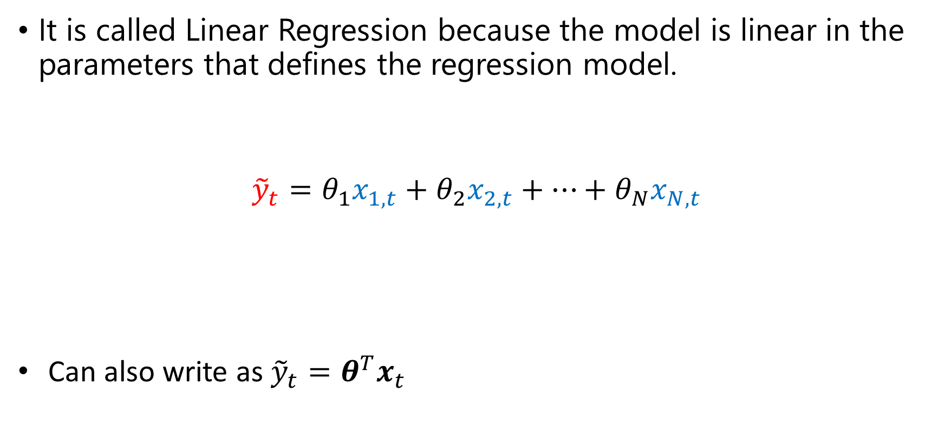

Linear Regression: Lest Squares
It is called Linear Regression because the model is linear in the parameters that defines the regression model.
$${\tilde{y}}_{t}=θ_{1}x_{1,t}+θ_{2}x_{2,t}+…+θ_{N}x_{N,t}$$
Can also write as ${\tilde{y}}_{t}=θ^{T}x_{t}$
Furnace faults at time $t$
Tag data at time $t$

Slide 4
Regression using Machine Learning techniques
As we give more information about the latent process (Furnace Faults), the relationship between the inputs and outputs would be clearer to the ML algorithm.
Hence, incrementing the number of observations would ease the learning process.
In other words, we should be able to see how the model converge to a solution as we increase the number of observations.

Slide 5
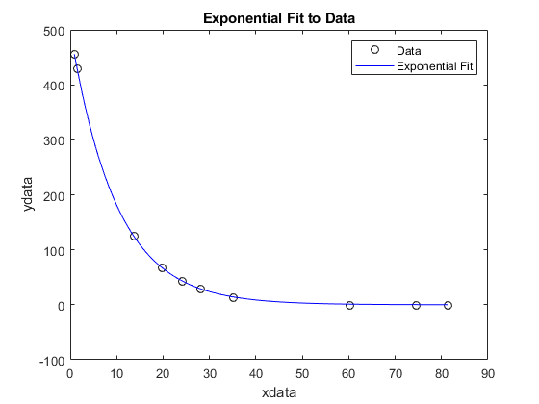
Linear regression: Least Squares
The model identifies the optimum parameter (converge to a solution) as we increment the number of observations.
One parameter associated with one input
Parameter / weight
N of observations

Slide 6
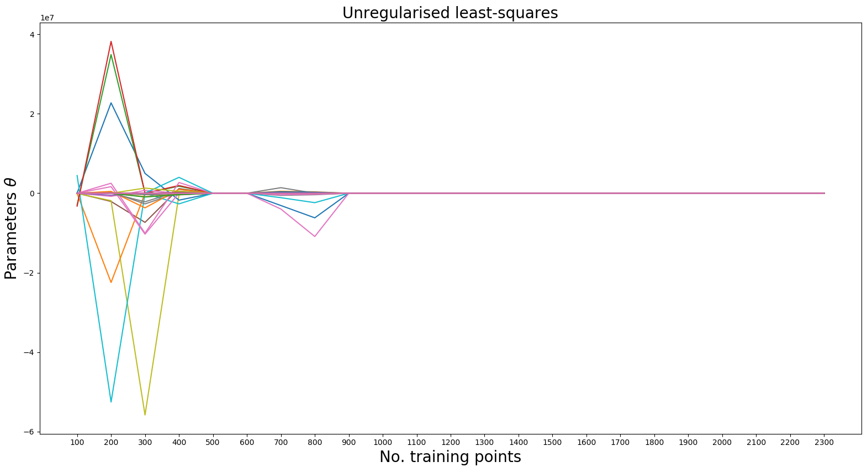
Linear regression: Least Squares
129 parameters associated with 129 inputs
Parameter / weight
N of observations

Slide 7
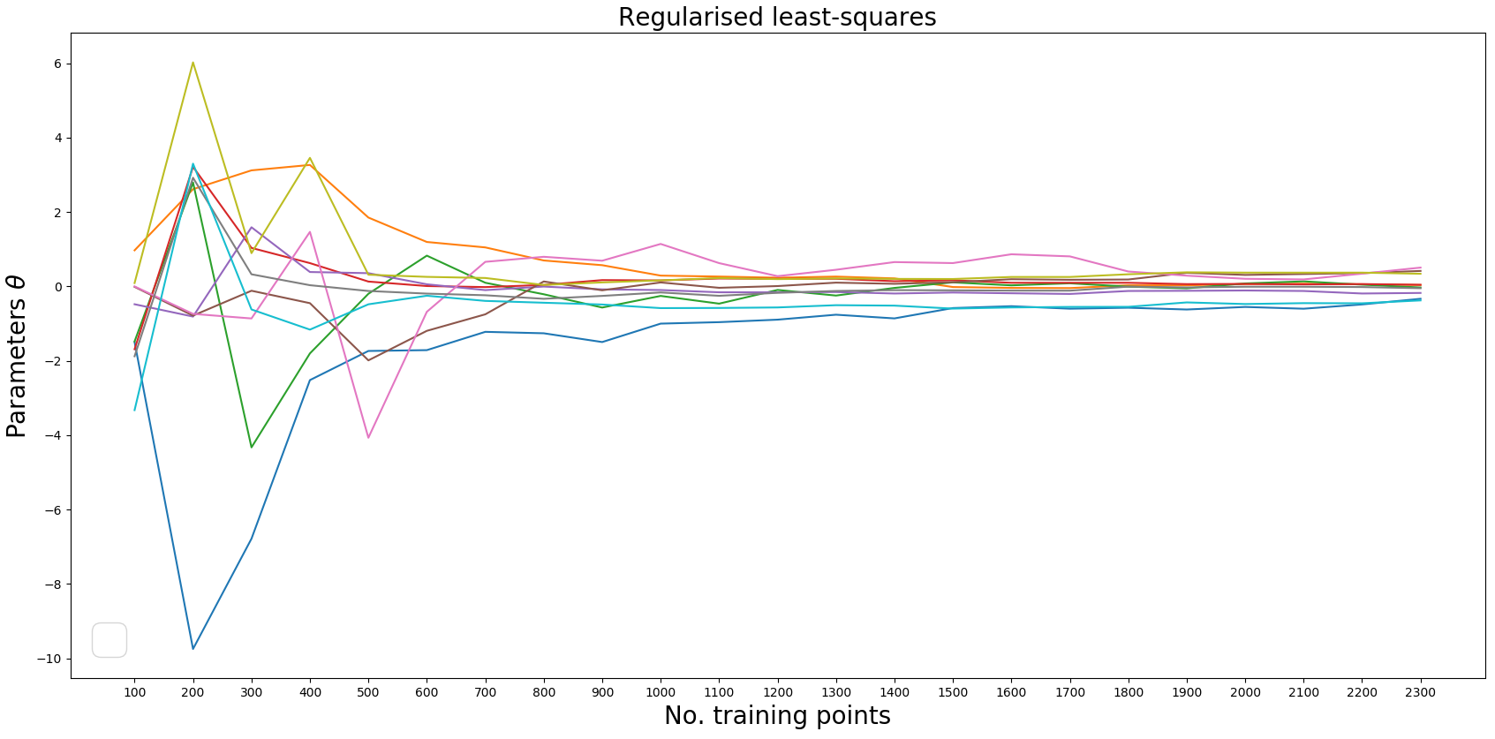

Linear regression: Regulasied Least Squares No time lags
10 parameters associated with the first 10 inputs
Reularisation parameter $λ$=0.001

Slide 8
Linear regression: Regulasied Least Squares No time lags
10 parameters associated with the first 10 inputs

Slide 9
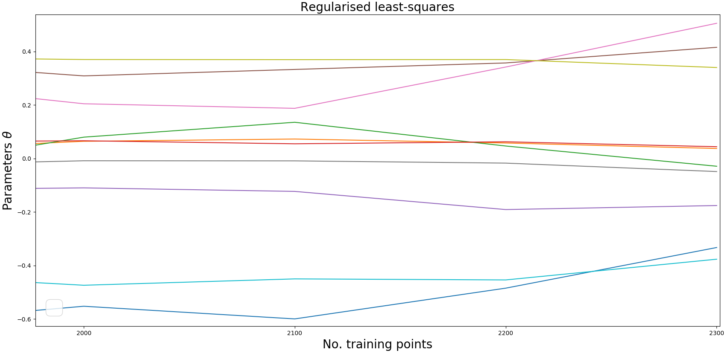
Regulasied Least Squares: Zoom in No time lags
10 parameters associated with the first 10 inputs
Reularisation parameter $λ$=0.001

Slide 10
Regulasied Least Squares:
We might be able to see how the parameters converge with more data
If the Regularised Least Squares parameters does not converge when increasing the training data, then we might be facing a regression problem with dynamic inputs.
Online Least Squares can update its parameters and thus capturing the dynamic behaviour of the inputs.

Slide 11
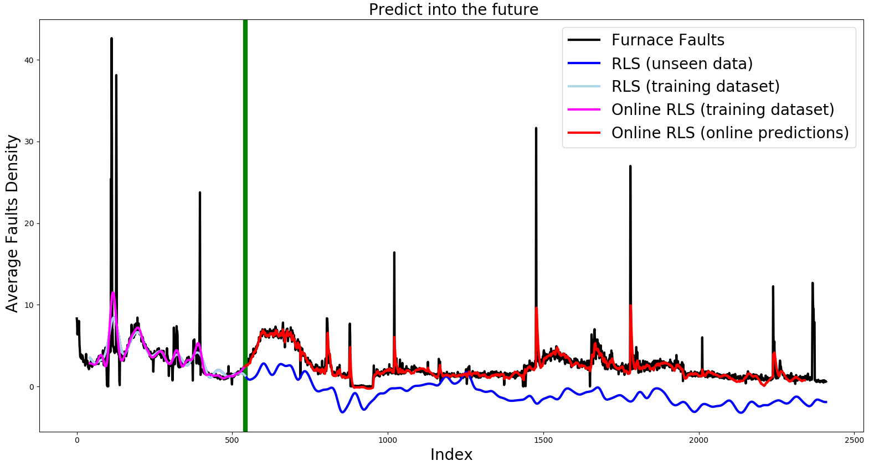
Online regularized least squares Time lag = 14 hours

Slide 12
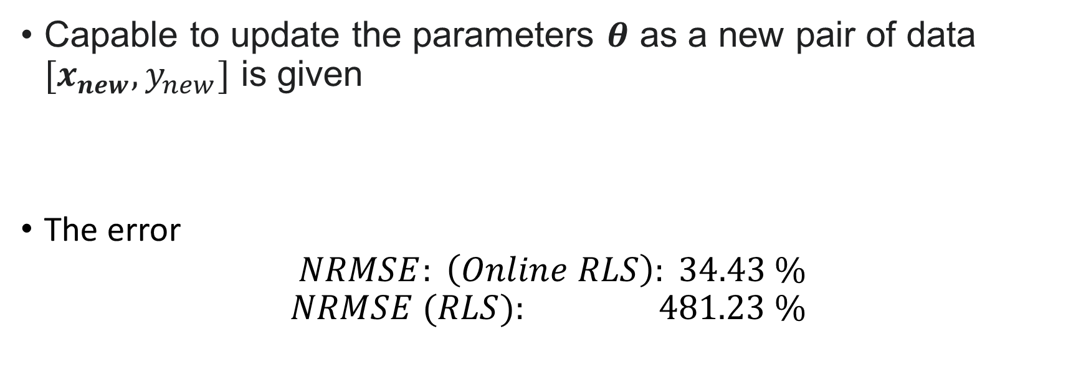
Online regularised least squares Time lag = 14 hours
Capable to update the parameters $θ$ as a new pair of data $[x_{new}, y_{new}]$ is given
The error
$$NRMSE: \left(Online RLS\right): 34.43 \% \\ NRMSE (RLS): 481.23 \%$$

Slide 13
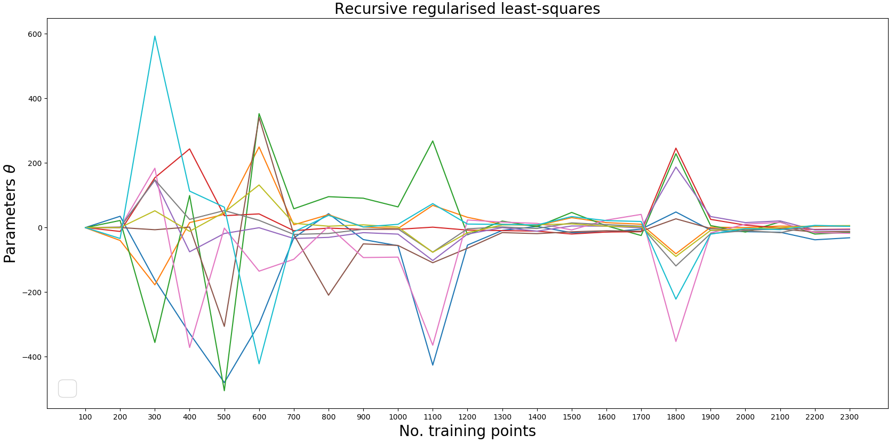

Linear regression: Online regularised least squares No time lags
10 parameters associated with the first 10 inputs
Reularisation parameter $λ$=0.8

Slide 14
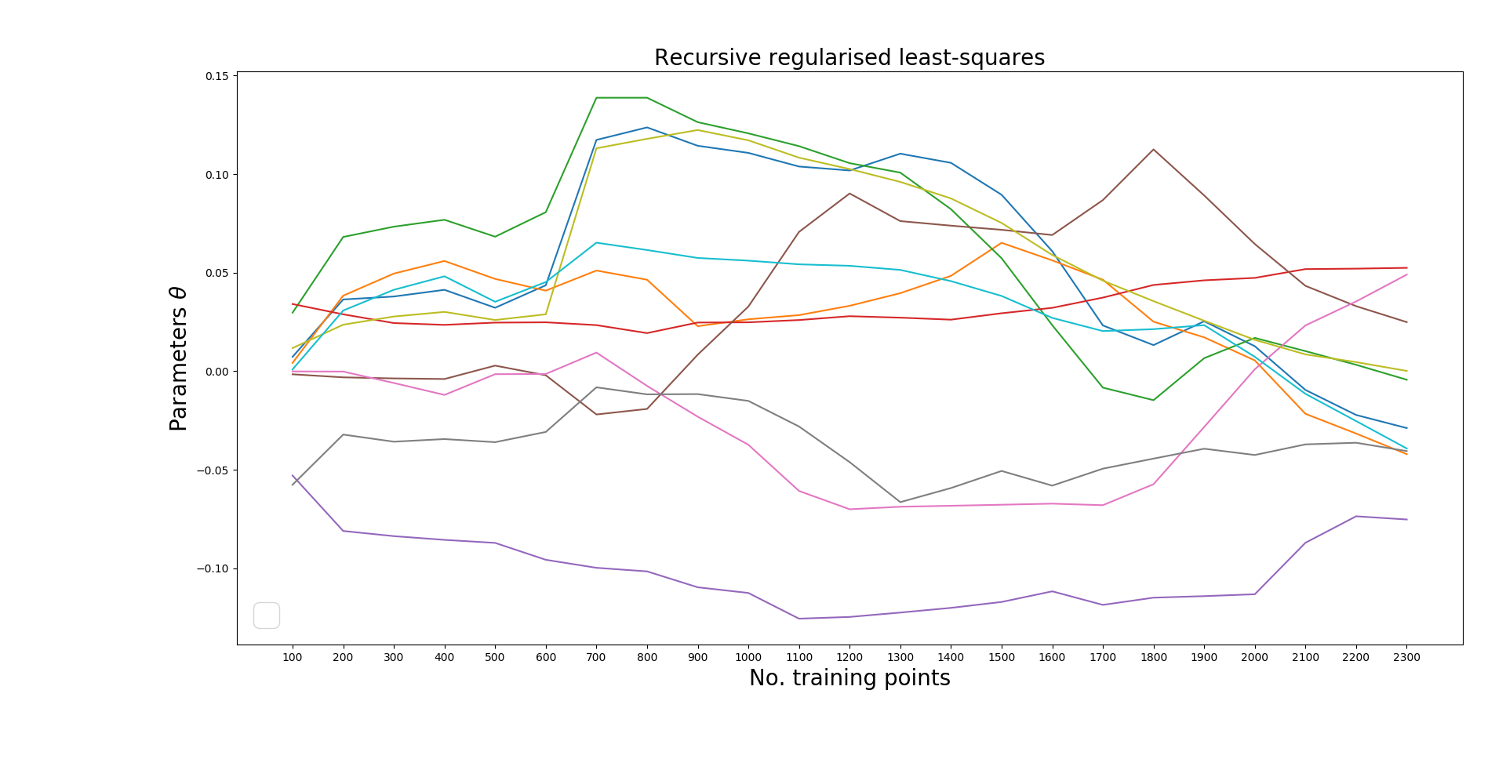

Linear regression: Online regularised least squares No time lags
Reularisation parameter $λ$=100
10 parameters associated with the first 10 inputs

Slide 15
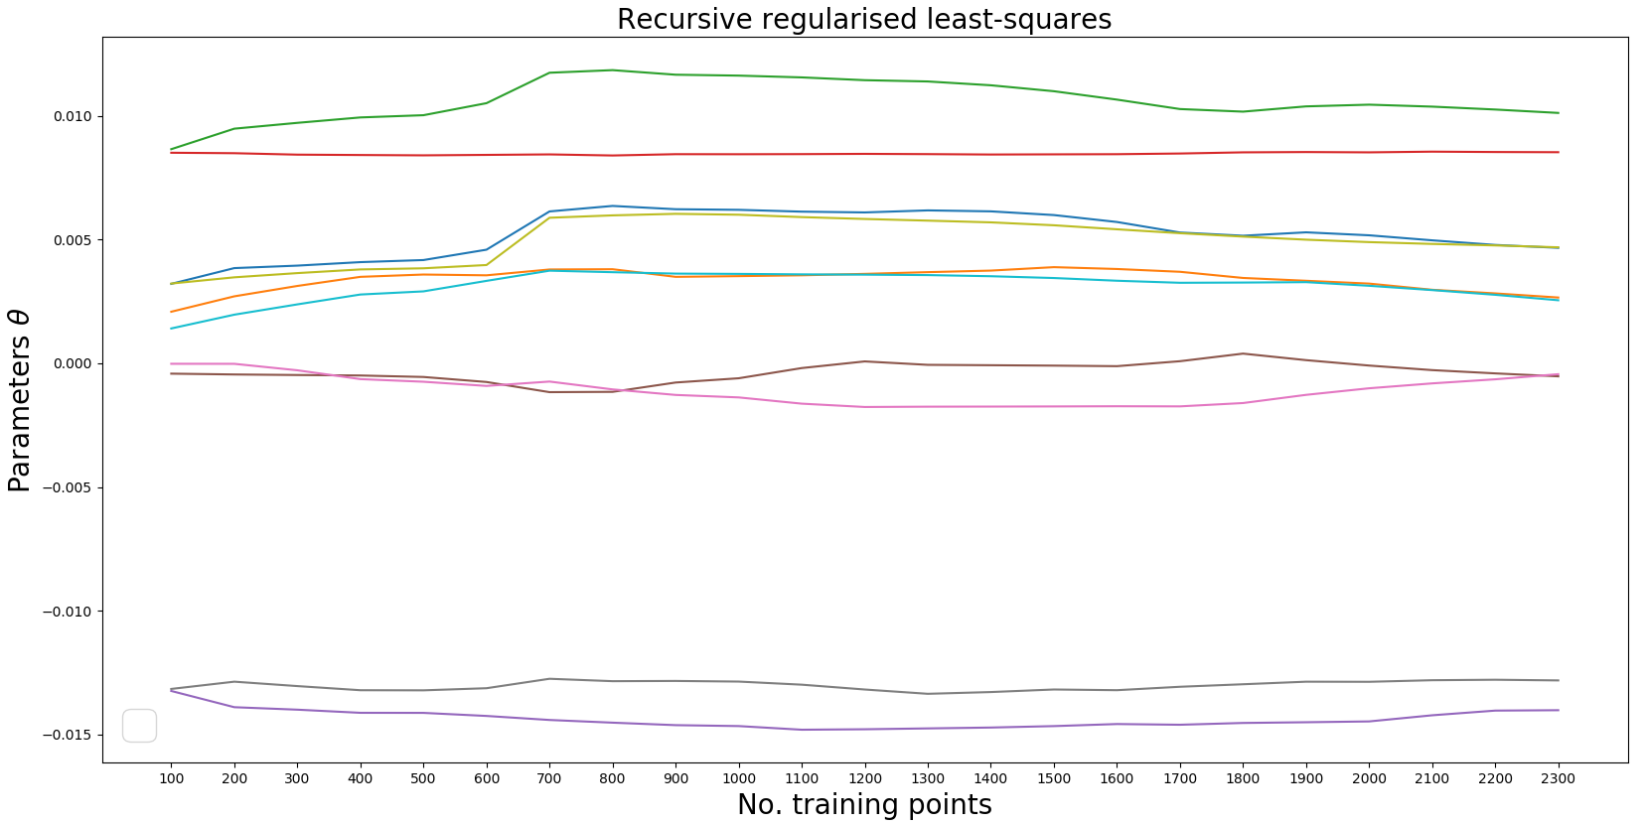

Linear regression: Online regularised least squares No time lags
10 parameters associated with the first 10 inputs
Reularisation parameter $λ$=1000

Slide 16
Thank you for your attention. ANY QUESTIONS?

Slide 17
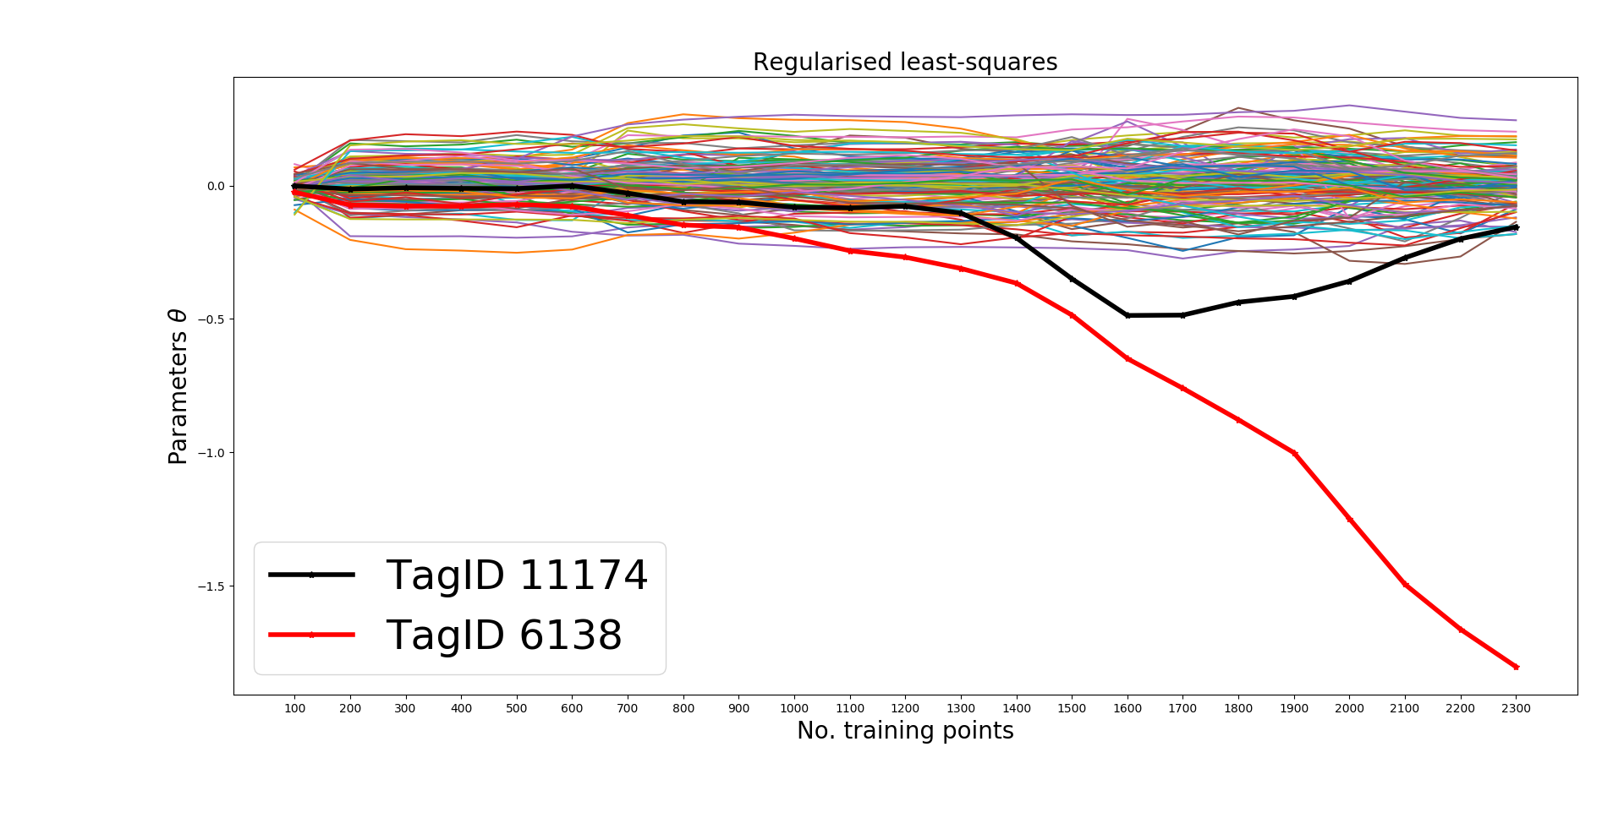
Linear regression: Regulasied Least Squares
129 parameters associated with 129 inputs

Slide 18
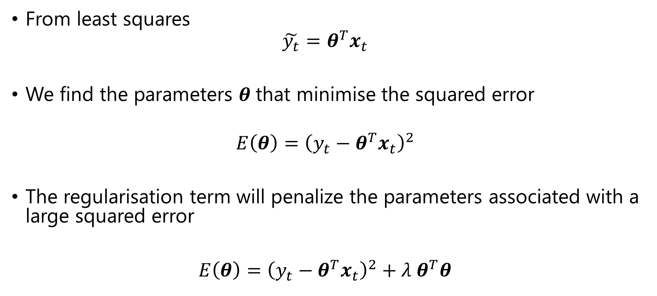
Regularised Lest Squares
From least squares
$$\tilde{y_{t}}=θ^{T}x_{t}$$
We find the parameters $θ$that minimise the squared error
$$E\left(θ\right)={\left(y_{t}−θ^{T}x_{t}\right)}^{2}$$
The regularisation term will penalize the parameters associated with a large squared error
$E\left(θ\right)={\left(y_{t}−θ^{T}x_{t}\right)}^{2}+λ θ^{T}θ$

